Slide 1
Automated IoT Home Garage System
Team 23:
Ahmed Helmy
Malak Ahmed
Omar Elgarawany
Malak Gaber
Loay Mohamed

Slide 2
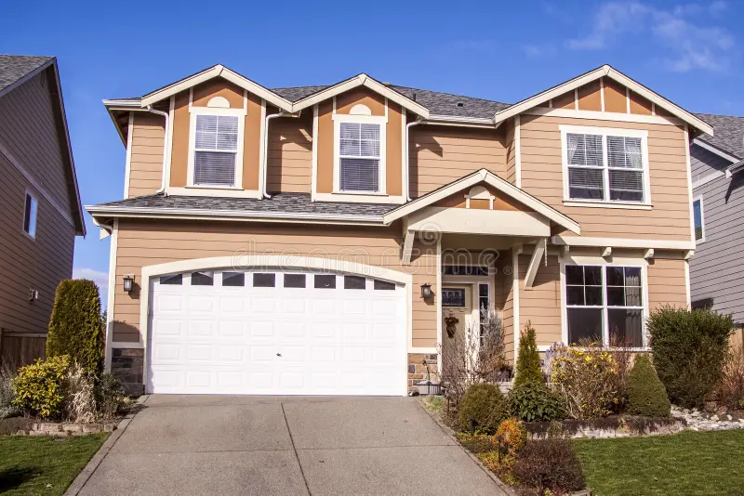
Overview
This project is about a home garage system designed for American style suburban houses (or similar), where the garage is a small building typically connected to the house. We designed this system such that it allows the garage door to open and close automatically when the owner pulls up into the driveway, or alternatively control the door from the mobile app.

Slide 3
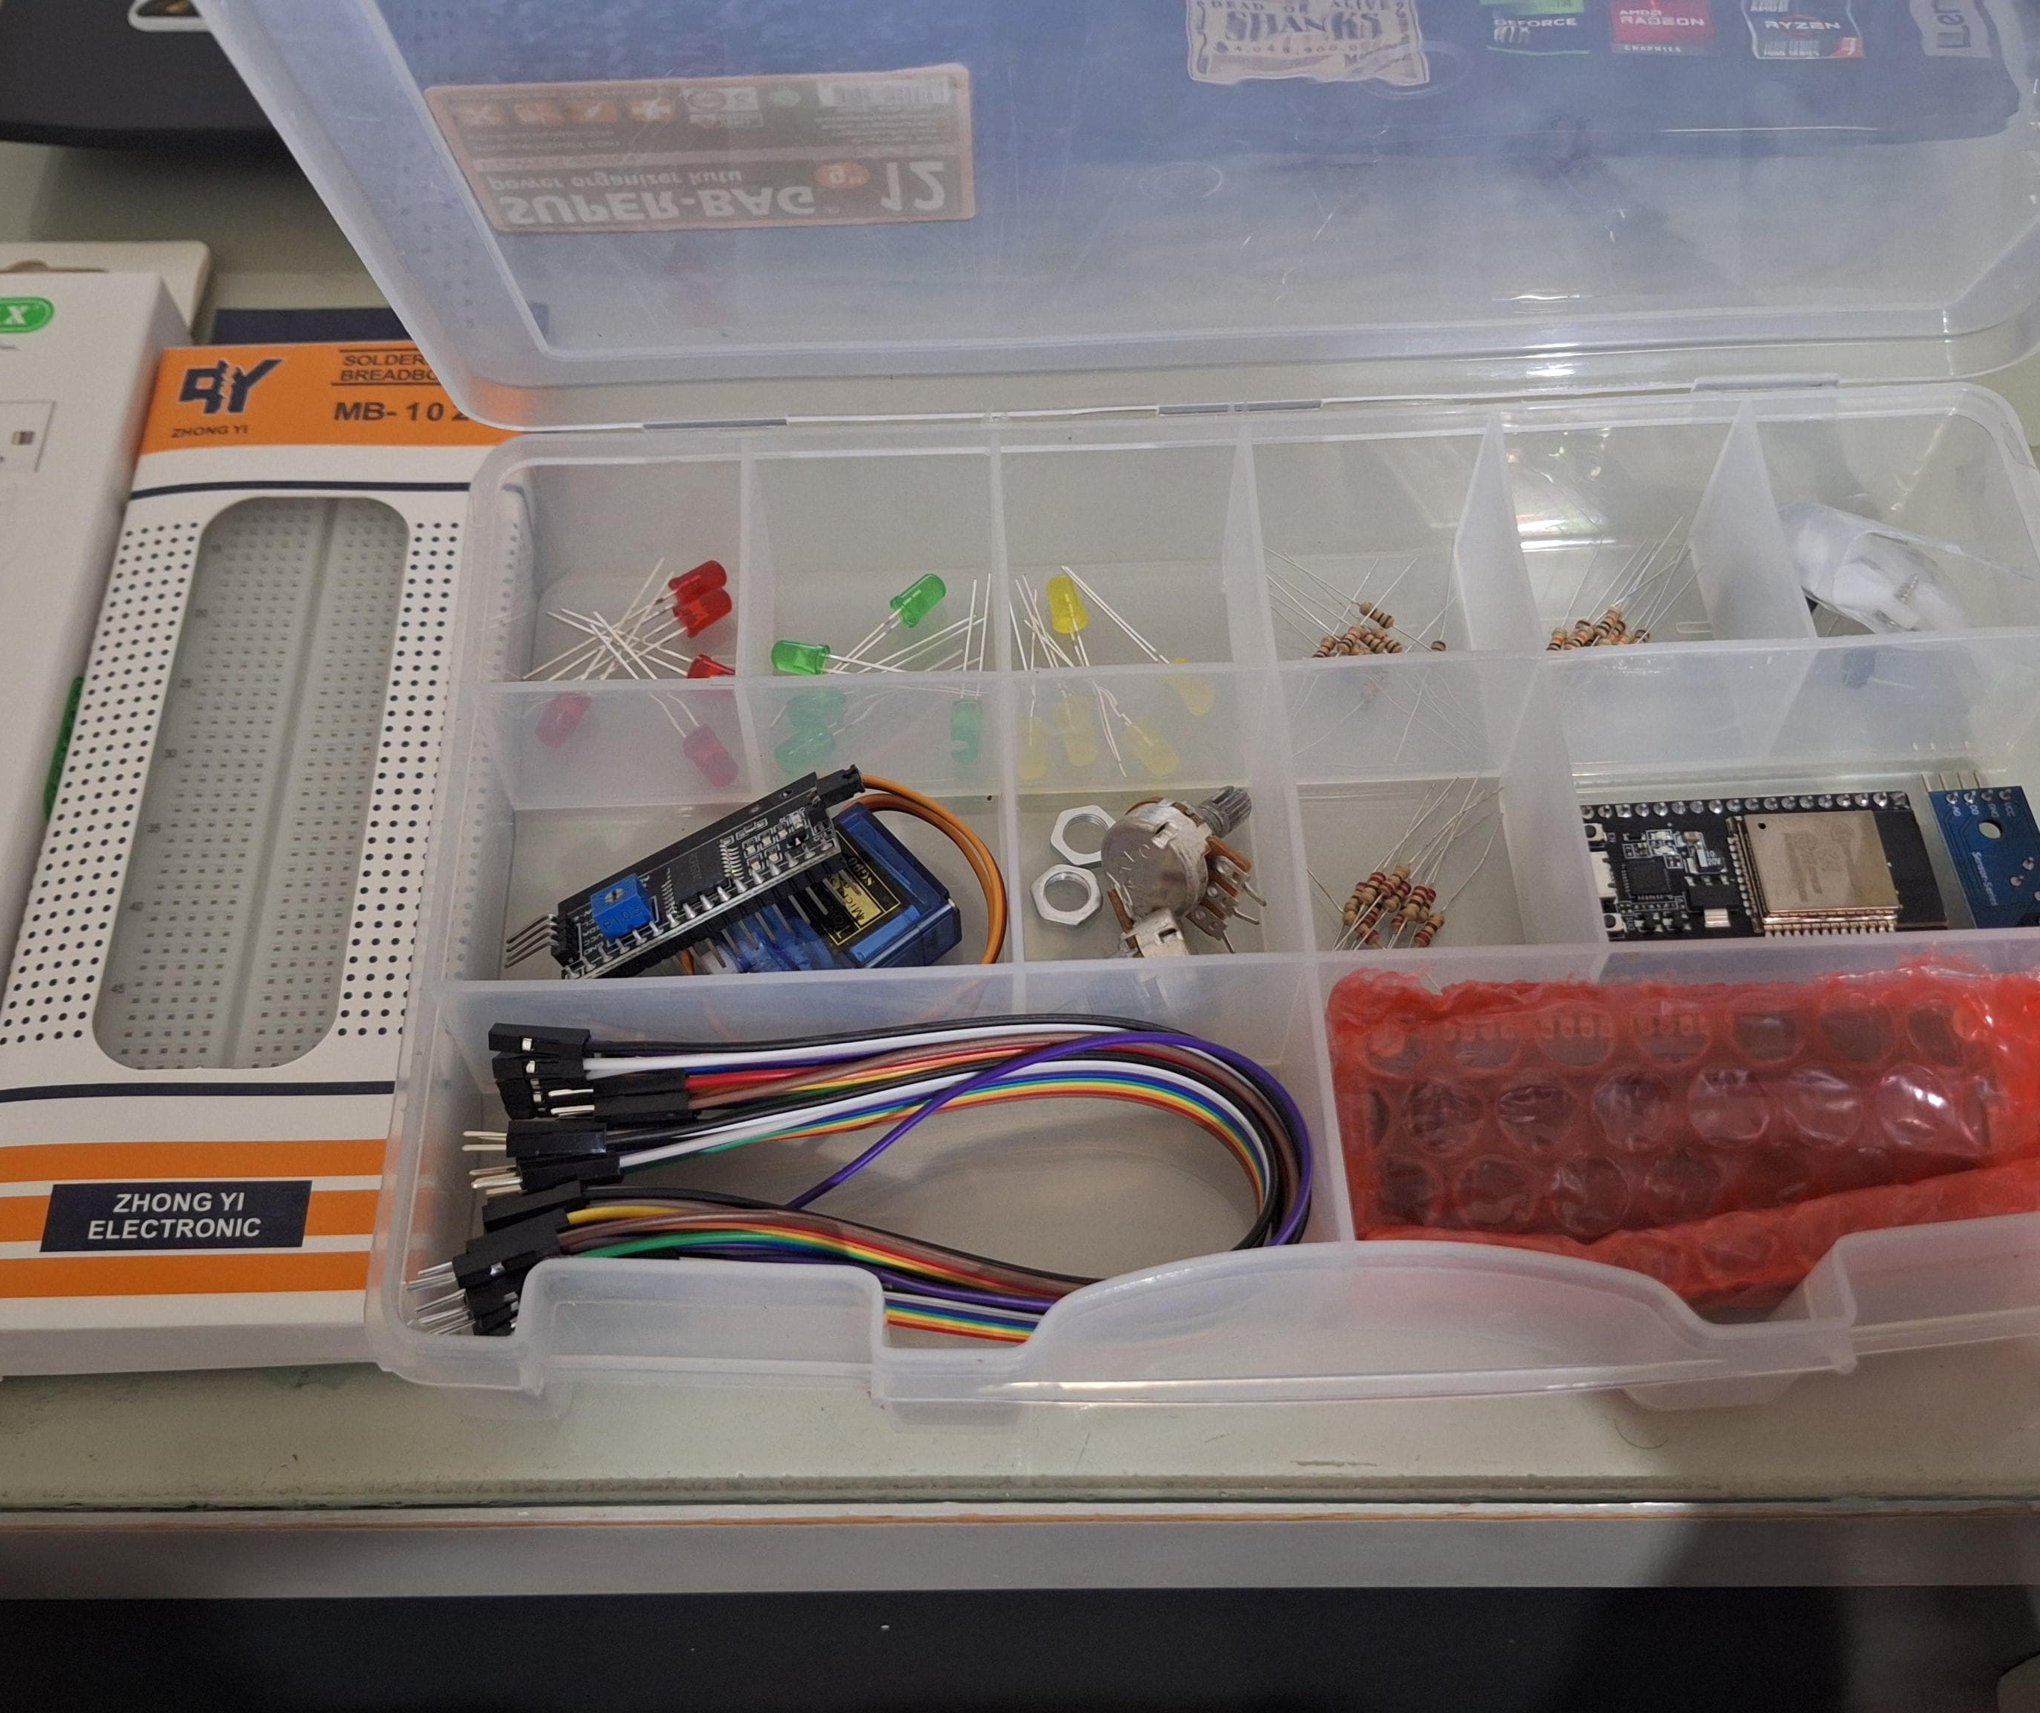
Used Components
Breadboard
ESP32
Jumper Wires
220 ohm resistor
Red LED
Infrared Sensor
Ultrasonic Sensor
Servo Motor
Buzzer
16x2 LCD with I2C Module

Slide 4
Circuit Logic
After all the component have been connected in the circuit, ESP32 code is written to receive input from the two sensors, IR and Ultrasonic. IR sensor detects if the car has pulled up to the garage and then sends a signal to the Servo Motor to open the garage door. The Ultrasonic sensor is positioned inside the garage and measures the distance from the furthest wall to the entering car, once the Ultrasonic sensor reads a distance of less than 10 cm (envisioned as the car being fully inside the garage and can park safely), the Buzzer is set off and the LED lights up, and a signal is sent to the Servo Motor to close the door, completing the parking process. During this entire process, the LCD displays all the data and actions being taken.

Slide 5



Networks and Connections
ESP32 given access to connect to Wi-Fi.
Connected to HiveMQ, MQTT Broker, to send Sensor data (and later, receive Servo Motor action data from mobile app to control door).
Database set-up on Supabase, stores username, password, action taken and the time of the action.

Slide 6
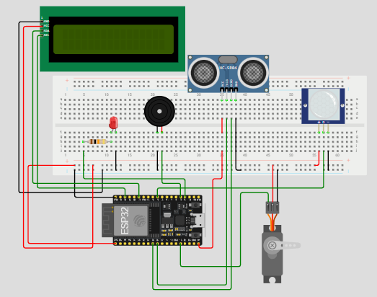
Simulation
Wokwi website used to simulate the circuit, giving the ESP32 access to Wi-Fi through ssid and password, Supabase through database URL and API Key, and HiveMQ through web client URL, port, username and password to send and store all necessary data.

Slide 7
Mobile App
Built using the Flutter framework, the mobile app is designed to allow users to login and:
Control garage door remotely (open/close)
Check real-time Ultrasonic reading
Check their previous user activity (door open/close, time of login)
Door control and Ultrasonic reading are sent and retrieved from HiveMQ connected to topics servo/control and Sensor/UltraSonic respectively.
User activity data is retrieved directly from Supabase.

Slide 8
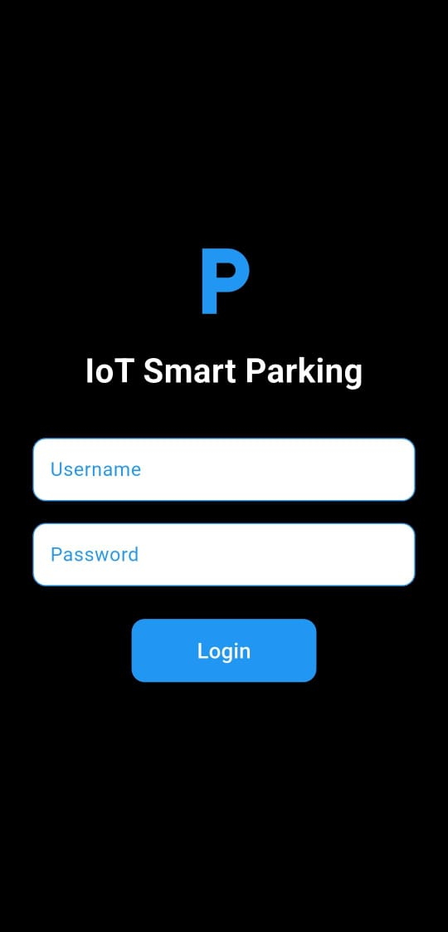
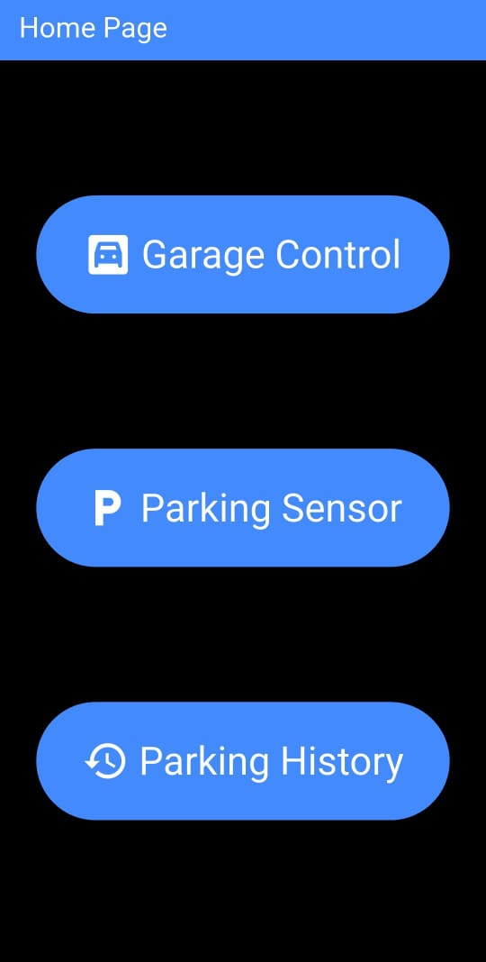
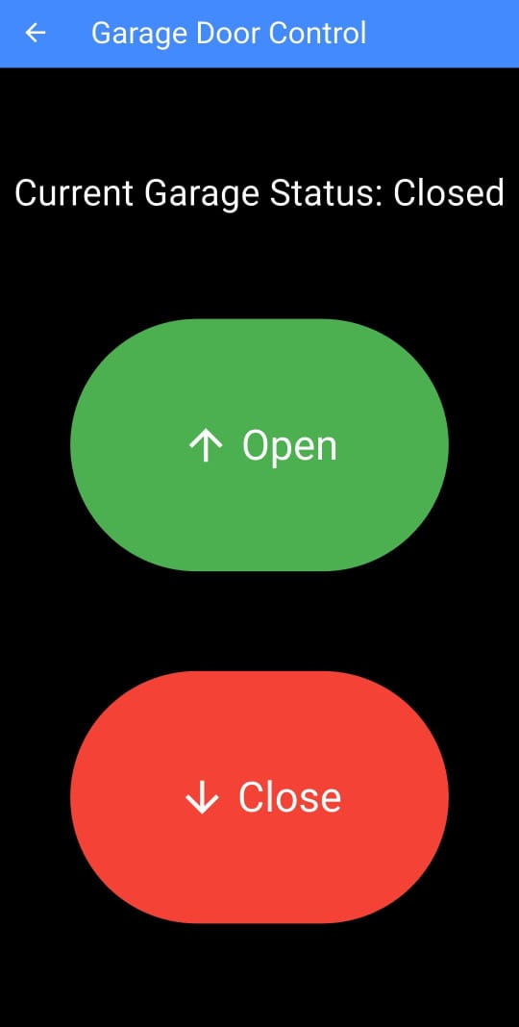
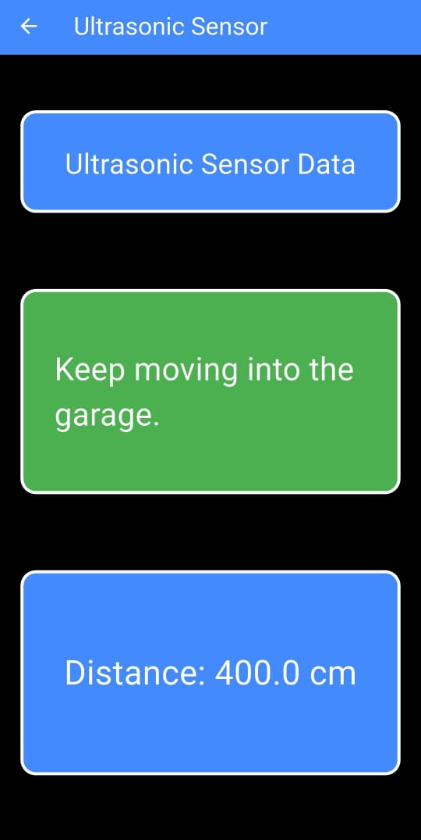
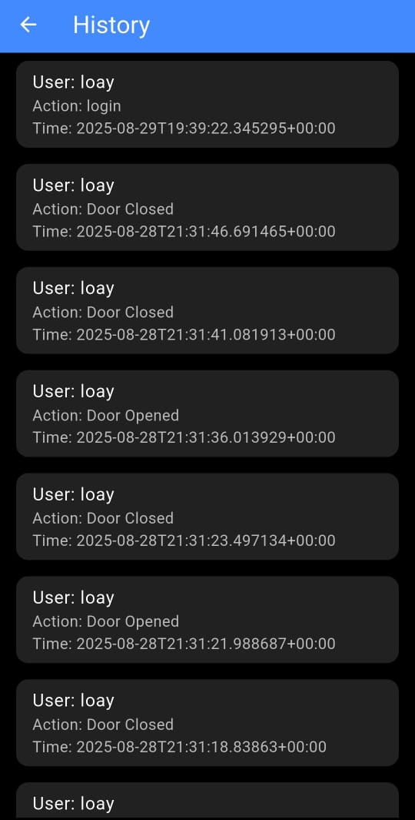
Layout and Navigation

Slide 9
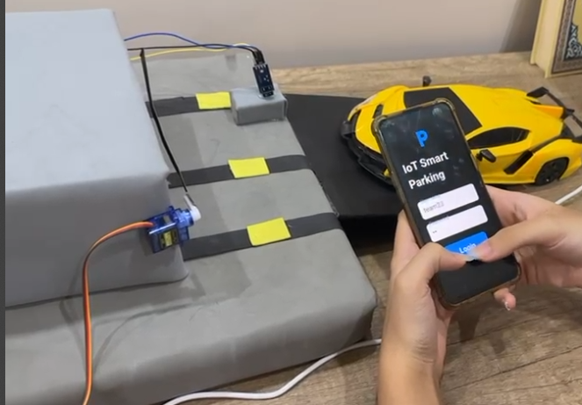
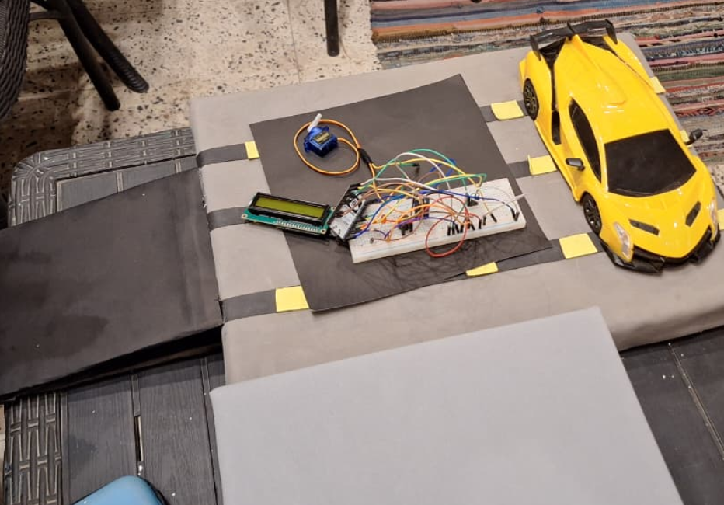
Maquette
The design used is that of a small garage building with a small ramp, the “garage building” has a hole cut into it where the Ultrasonic Sensor is placed inside, on the outside the Infrared Sensor is placed to detect the car pulling up and opens the Servo Motor and lifts a barrier to allow the car to enter.

Slide 10
Challenges
Throughout the project there have been several problems that have appeared:
Logical errors in Arduino code.
Incorrect circuit connection and setup
Circuit components not working as intended due to low power
Flutter app not connecting to MQTT Broker
Flutter app apk not connecting to Wi-Fi

Slide 11
Solutions
Problems encountered during development have been resolved using the following methods:
Implementing the use of enums in Arduino to keep code clean and easier to debug.
Checking if each component works separately and then connecting them to the 5V pin of the ESP32.
Updating the open-source code for Flutter MQTT connection to work for the newest version of Flutter.
Adding internet connection permission in the Android Manifest file in the Flutter app project folder

Slide 12
Future Enhancements
Even though we are proud with what we have achieved during this project, there are still some things we are still unsatisfied with and believe need further optimization, which include but are not limited to:
Implementing Security features
Better Database design
Better looking user interface for the Flutter app
More features and screens in the Flutter app

Slide 13
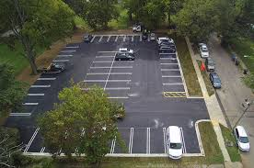
Larger Application
Expanding on this project, a system could be made to use this technology to create a public parking lot with sensors that detect the cars’ distance and update a web/mobile app to display that this parking space is currently occupied, then a timer is started to calculate the parking fee.
Could be implemented in malls, public parks, universities, etc.

Slide 14
Conclusion
In the end, by integrating sensors and actuators and networks into a garage, we were able to make a common everyday task easier, safer and more convenient.
This project demonstrates the capabilities, and many uses for ESP32 in IoT solutions to improve efficiency and convenience, while setting up a foundation for larger applications used in smart homes and public infrastructure, which could then be scaled up even more to form a smart city ecosystem.

Slide 15

Thank You

